Slide 1
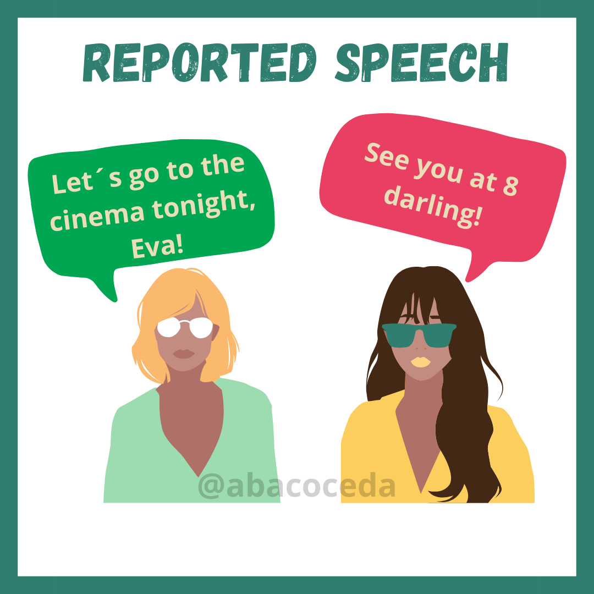
Notes:
https://www.youtube.com/watch?v=DaDYIx_cQYE

Slide 2
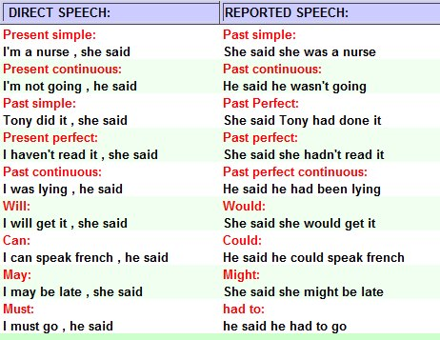

Slide 3
PLACE & TIME
today | that day
now | then/at the moment
yesterday | the day before
….days ago | ...days before
last week | the week before
next year | the following year
tomorrow | the next day/the following day
here | there
this | that
these | those
ago | previously/before
tonight | that night
MODAL VERBS
will | would
can | could
must/have to | must/had to
may/might | might
should | should
ought to | ought to

Slide 4
1) "He works in a bank."
2) "Julie doesn't like going out much."
3) "I don't have a computer."
4) "They never arrive on time."
She said he worked in a bank.
She said Julie didn't like going out much.
She said that she didn't have a computer.
She said they never arrived on time.

Slide 5
1) "I'll go to the cinema later."
2) "We'll meet the children at six."
3) "She will be late."
4) "Lucy will definitely come."
5) "I will stop smoking on Tuesday."
She said she would go to the cinema later.
She said they would meet the children at six.
She said she would be late.
She said Lucy would definitely come.
She said she would stop smoking on Tuesday.

Slide 6
1) "Jane left the party early."
2) "I didn't go out at the weekend."
3) "They visited Japan."
4) "She didn't buy the dress."
He told me Jane had left the party early.
He told me he hadn't gone out at the weekend.
He told me they had visited Japan.
He told me she hadn't bought the dress.

Slide 7
Write one sentence with the word given:
Aimar - can
Jon M. - will
Markel E. - a verb in present simple
Markel O. - a verb in present simple
Paula - present continuous
Jon H. - past simple
Álvaro - past simple

Slide 8
https://wordwall.net/resource/11221385/reported-speech/reported-speech-revision-statement-command
Notes:
https://wordwall.net/resource/1797799/%D0%B0%D0%BD%D0%B3%D0%BB%D0%B8%D0%B9%D1%81%D0%BA%D0%B8%D0%B9/reported-speech

Slide 9
1) "Did you arrive before seven?"
2) "How was your holiday?"
3) "I would have visited the hospital, if I had known you were sick."
4) "Don't touch!"
5) "Do you usually cook at home?"
She asked me if I had arrived before seven
She asked me how my holiday had been.
She said that she would have visited the hospital, if she had known I was sick.
She told me not to touch.
She asked me if I usually cooked at home

Slide 10
1) "Where is he?"
2) "What are you doing?"
3) "Why did you go out last night?"
4) "Who was that beautiful woman?"
5) "How is your mother?"
6) "What are you going to do at the weekend?"
She asked me where he was.
She asked me what I was doing.
She asked me why I had gone out last night.
She asked me who that woman had been.
She asked me how my mother was.
She asked me what I was going to do at the weekend.

Slide 11
1) "Don't do it!"
2) "I'm leaving tomorrow."
3) "Please get me a cup of tea."
4) "She got married last year."
5) "Be quick!"
She told me not to do it.
She said that she was leaving tomorrow.
She asked me to get her a cup of tea.
She said that she had got married last year.
She told me to be quick.

Slide 12
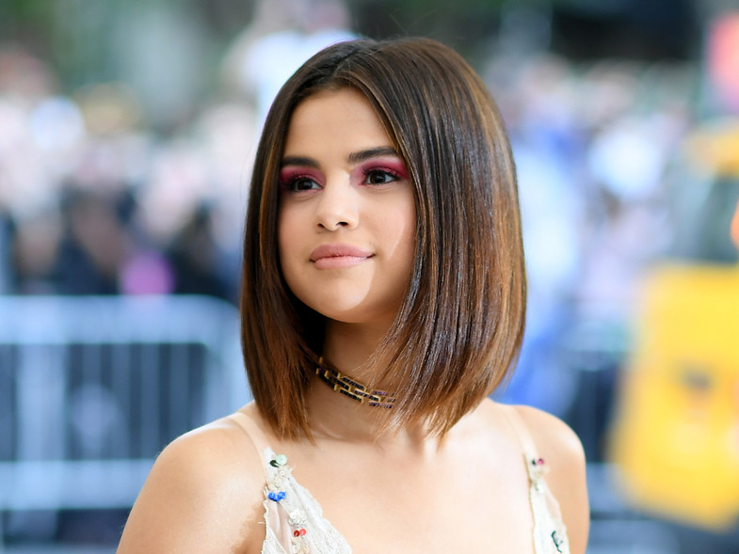
S
E
L
E
N
A
G
O
M
E
Z
Notes:
https://www.youtube.com/watch?v=_GFkHA5EZdE&t=53s

Slide 13
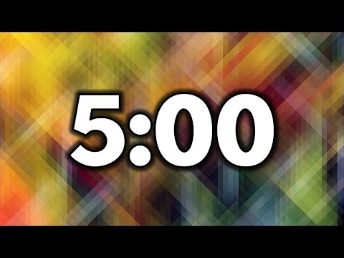
What’s the most enjoyable activity when you are at home?
Do you have any hidden talents?
Can you say anything in a foreign language?
What’s your current obsession?
What do you do on your days off?
What’s one hobby you are planning on taking up?
What’s the one thing you can never live without?
What’s one hobby you will never give up?
Who do you look up to most in your life?

Slide 14
Your favourite movie as a child?
How do you describe yourself in three words?
What scares you the most?
What makes you the angriest?
When do you feel most beautiful?
What’s your spirit animal?
What’s your favourite candy?
What’s your least favourite thing to eat?
What’s one thing people would be most surprised to know about you?

Slide 15

You are all at a very formal cocktail party
Everybody must circulate and talk to each other
You must say what is on your card and as little else as possible
Afterwards you’ll have to report back on what other people told you, using reported speech.

